Slide 1
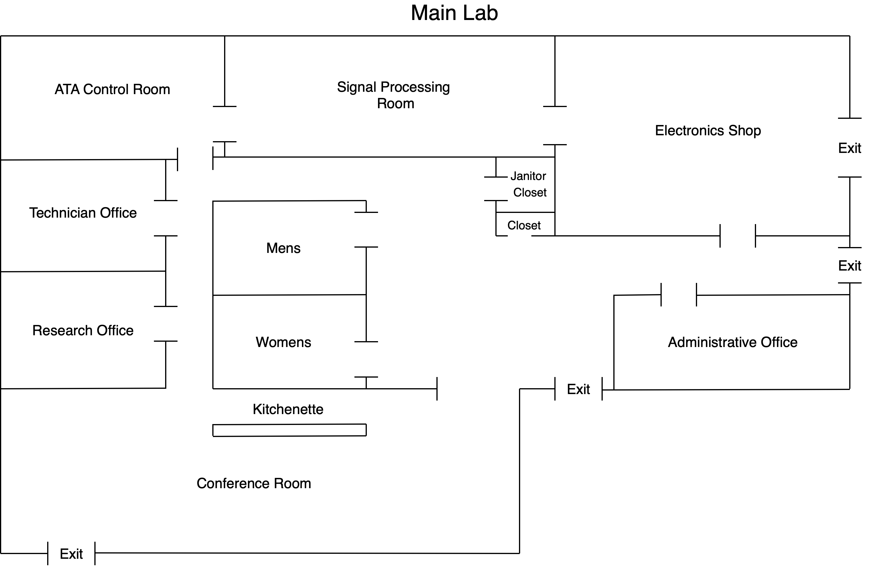

Slide 2
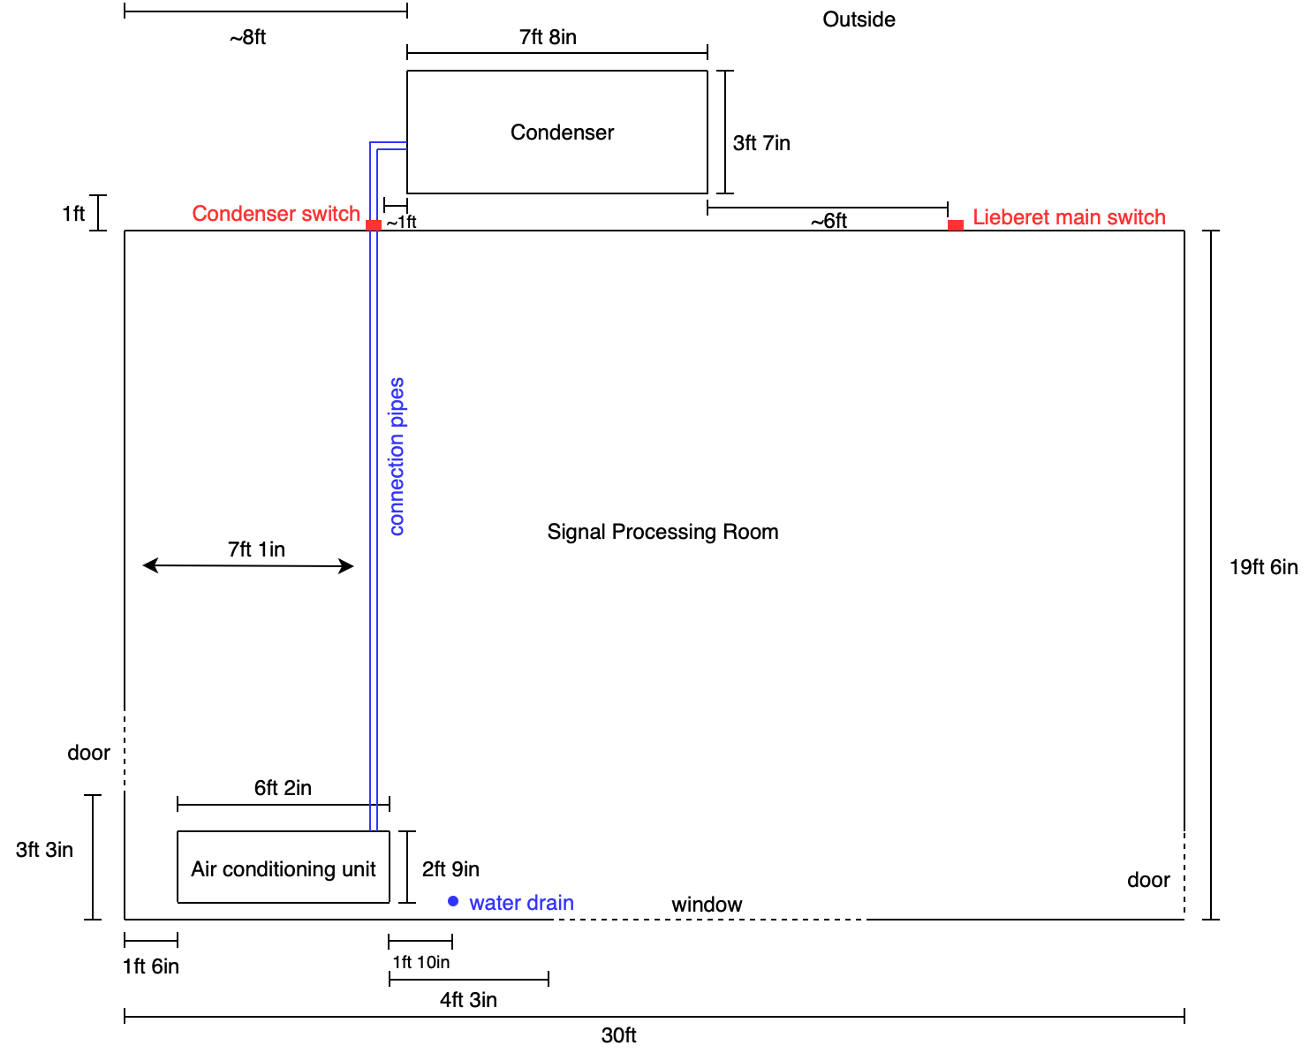

Slide 3
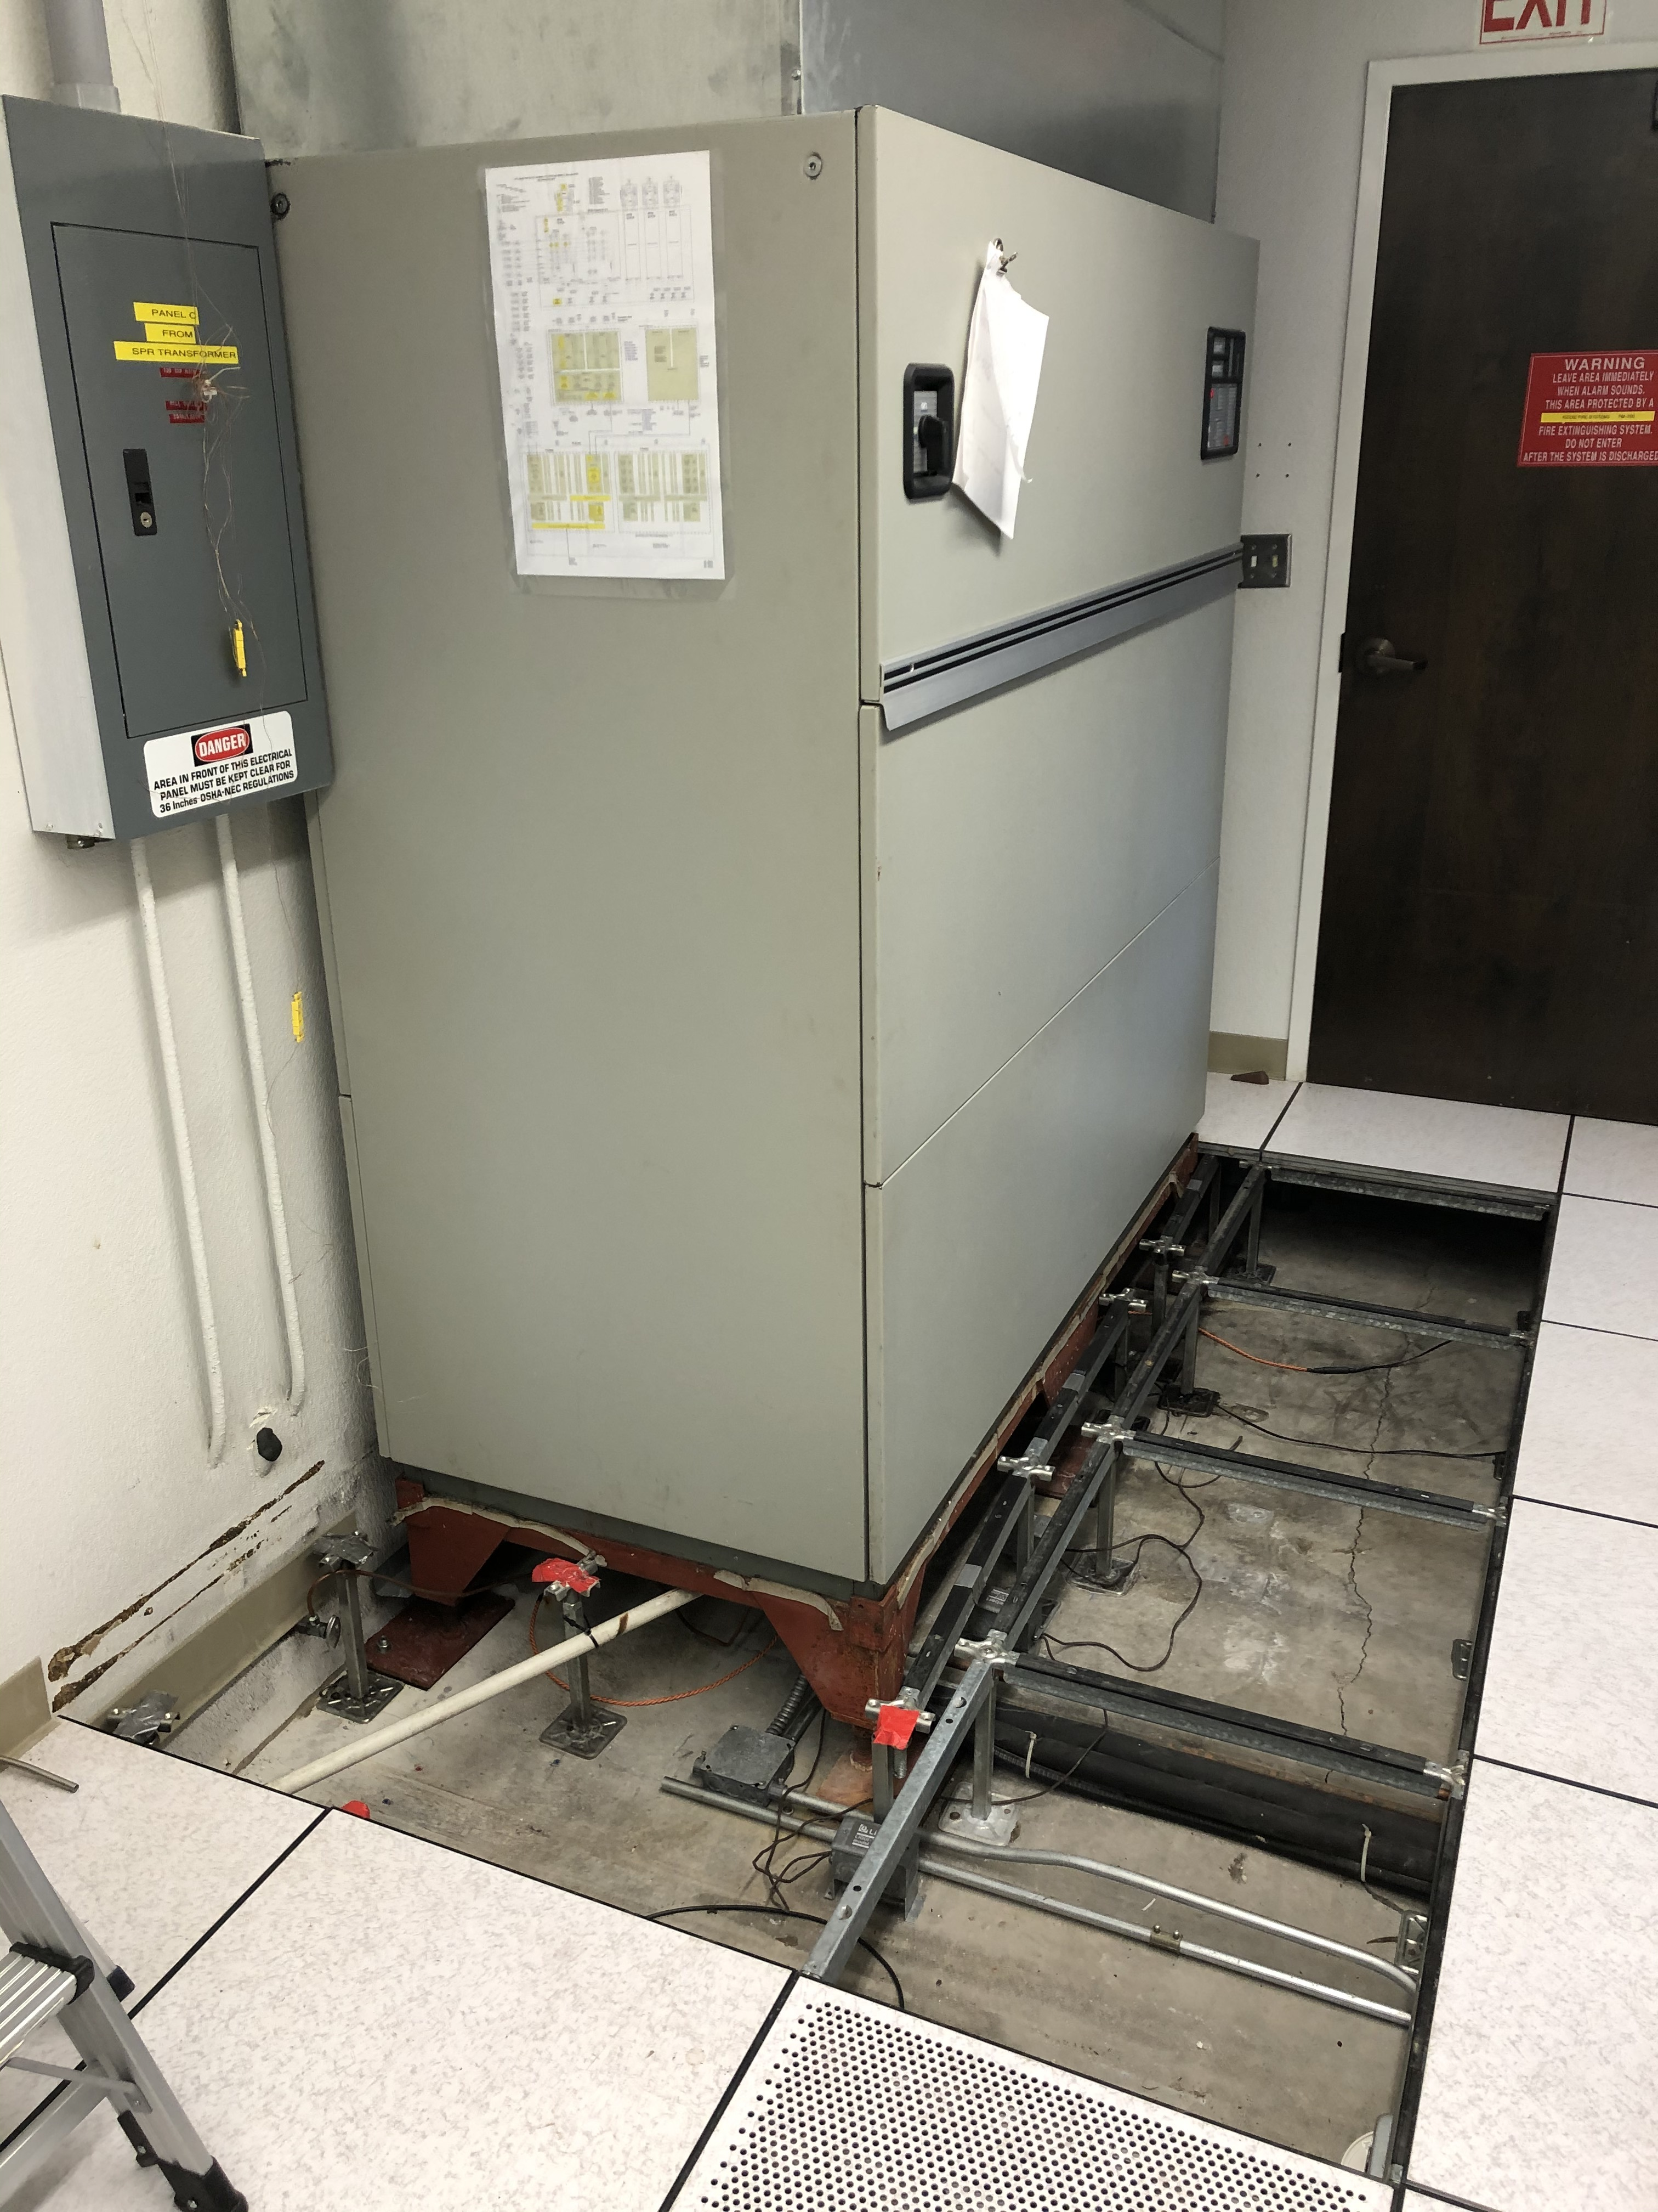
11inches between raised floor and cement foundation
Pipes that connect to the compressor outside
Pipe to water drain

Slide 4
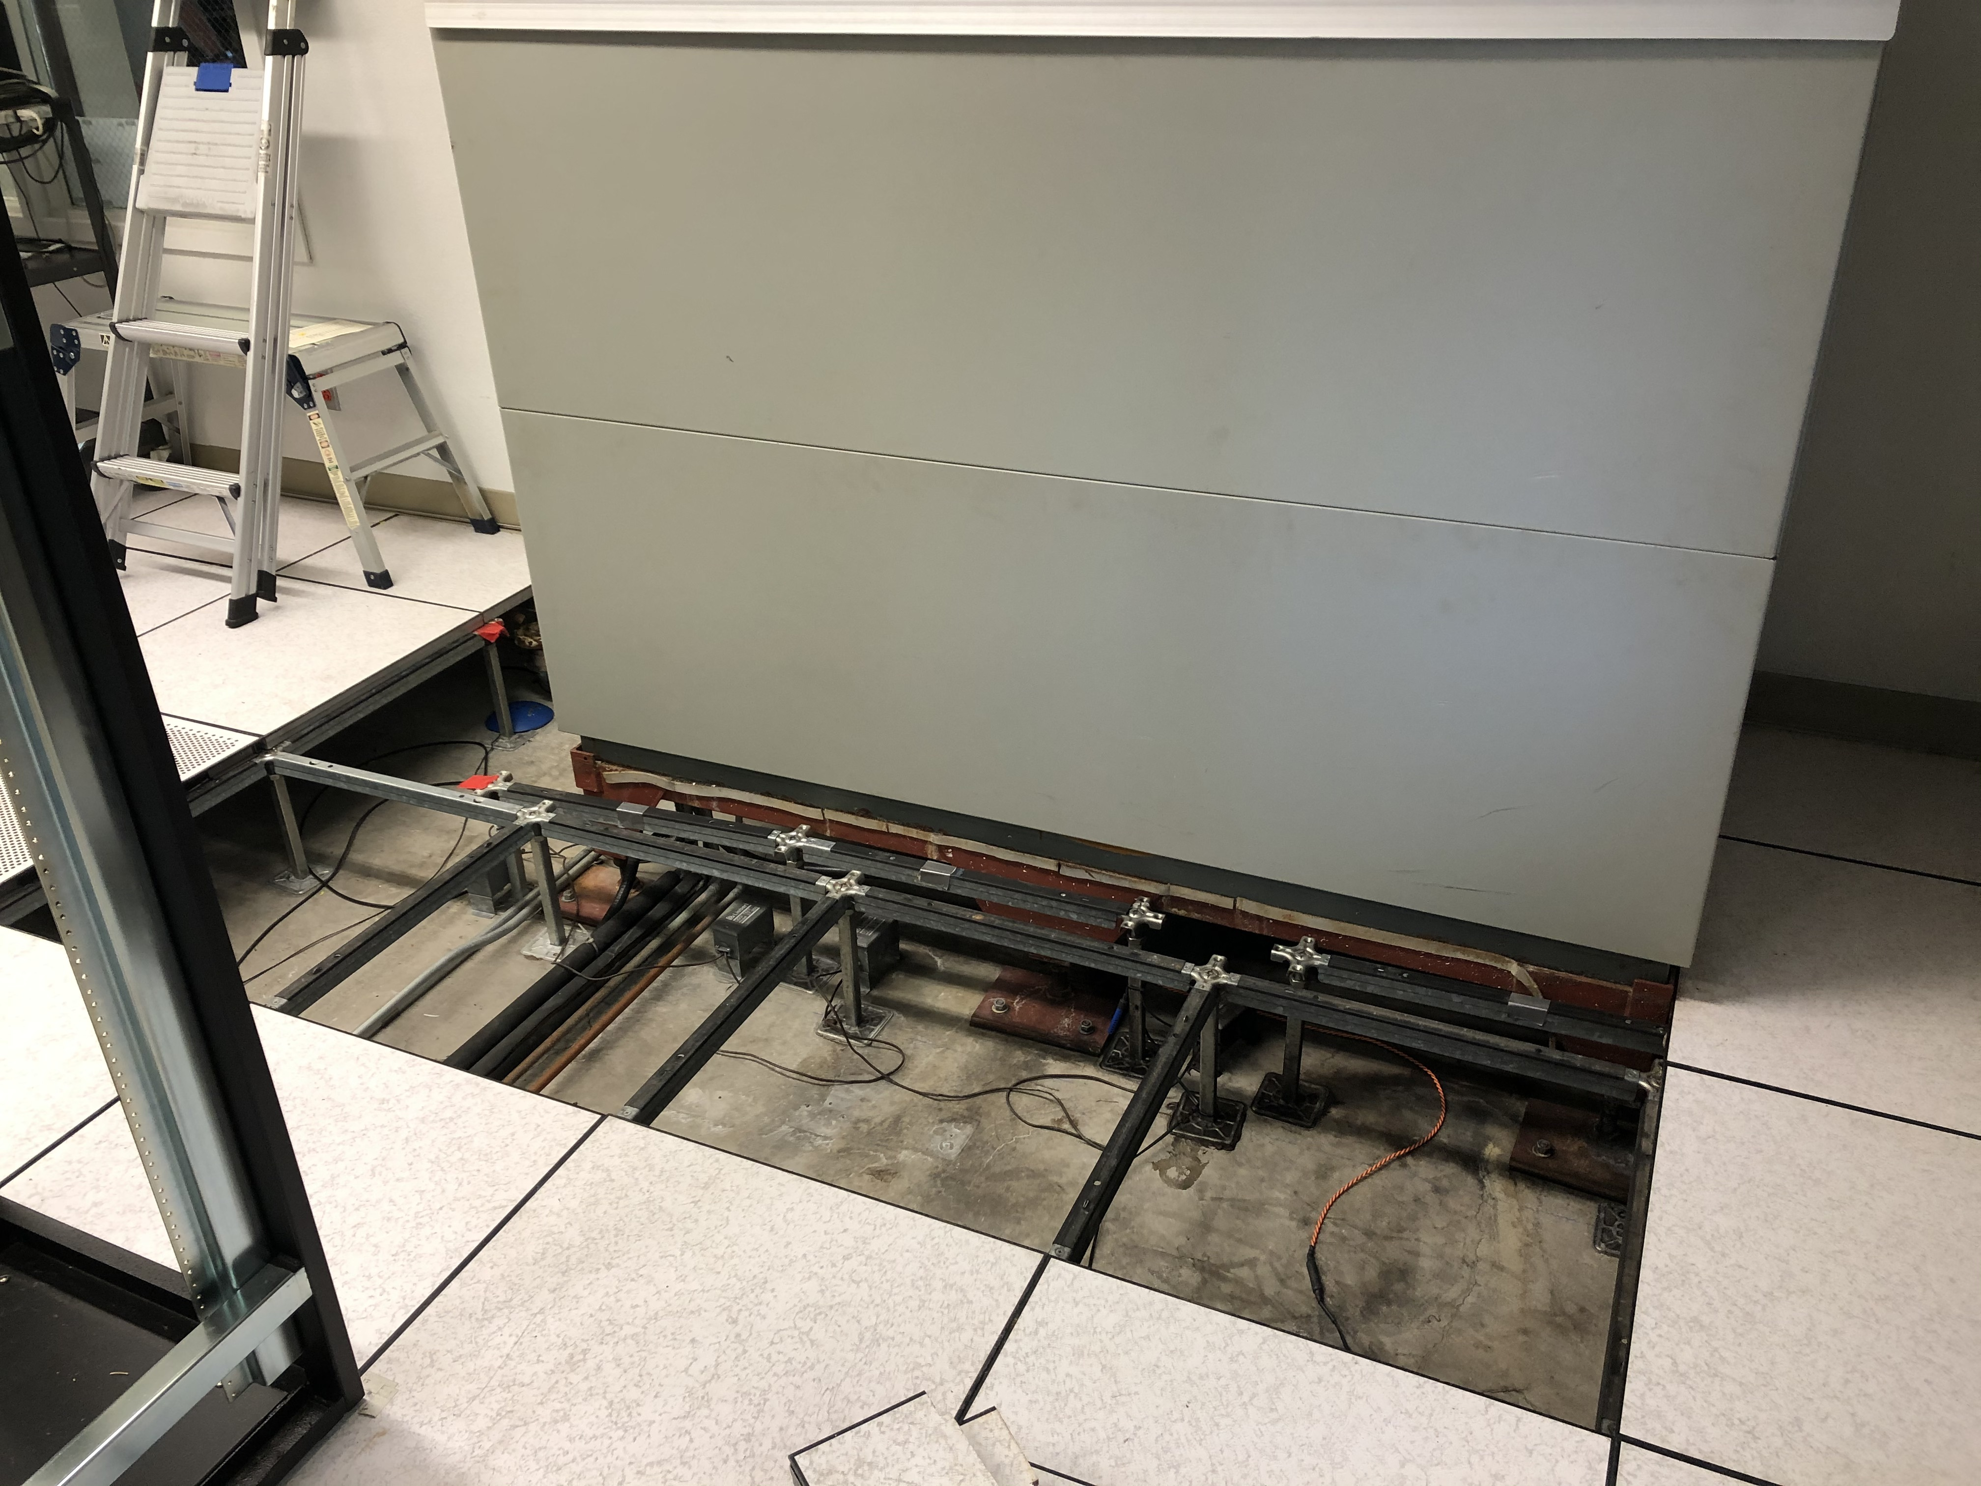
11in
Connector pipes

Slide 5
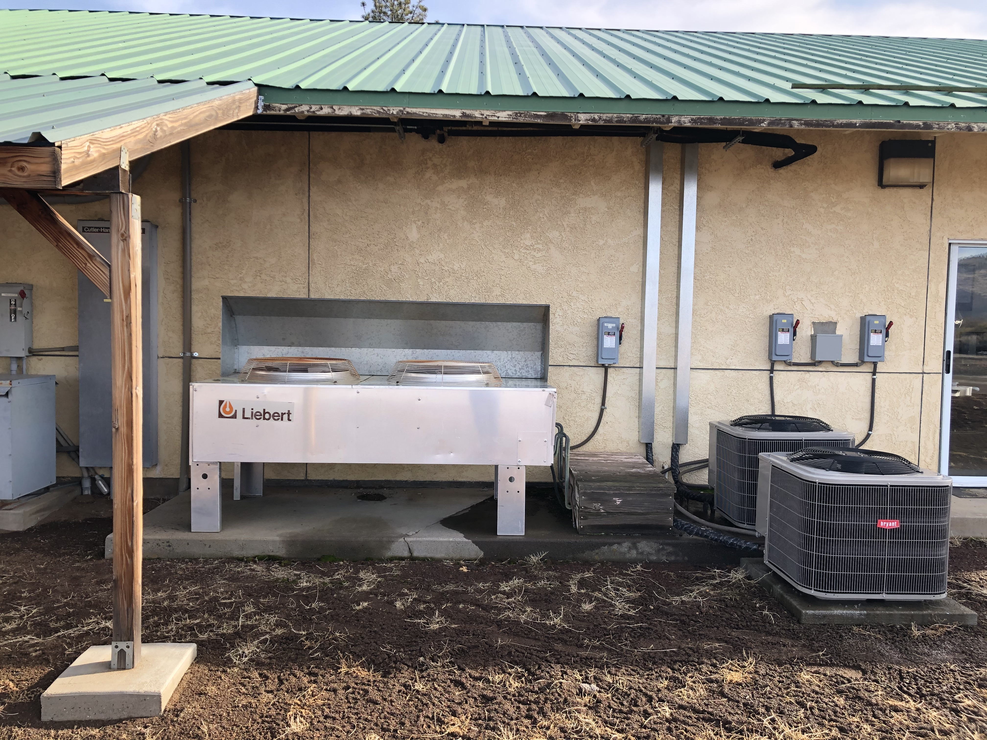
Condenser
Connector pipes contained within wood box

Slide 6
Wire size from power panel at generator is #6 to disconnect on Main Lab
Wire size from disconnect to machine is #8
Breaker size at power panel is 70 amp
Disconnect on Main Lab is 60 amp fused

